Slide 1
Uncovering the underlying visual representations of visual memory overtime

Slide 2
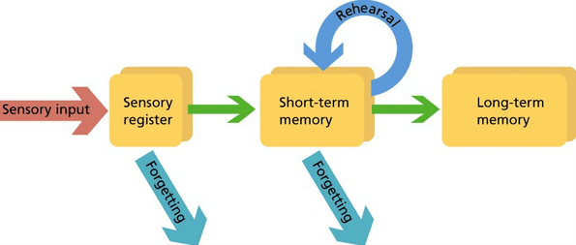
Memory consolidation process
Memory representation changes from short term memory (Hippocampus based) to long term memory (Neocortex based).
Short term memory is detailed (low level features) while long term memory is mostly gist based (high level features).
Detailed memory
Memory gist
(Winocur & Moscovitch, 2021)

Slide 3
Multiple aspects of memory gist
Color is associated with scene gist (Castelhano & Henderson, 2008).
Texture provides a strong cue for scene identification during early scene processing (Renninger & Malik, 2004).
The spatial layout properties provide a statistical summary of an image and able us to identify the gist of an image (Oliva & Torralba, 2006).

Slide 4
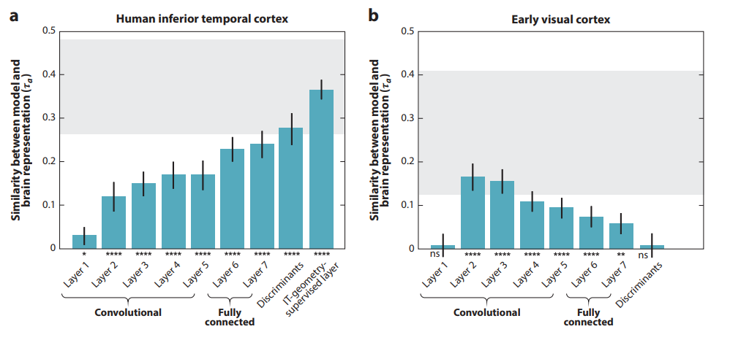
CNN and human visual hierarchal processing
Representational similarity in the visual stream corresponds with CNN hierarchy.
(Kriegeskorte, 2015) (Yamins & DiCarlo, 2016)
Notes:
הראו לנבדקים ב FMRI תמונות של אובייקטים וביצעו סריקות של האיזורים הויזלאוליים הרלונטים.
הוציאו מהמודל של האקטיבציה עבור אותן התמונות.
חישבו מדד של דימיון (קורלציה) בין ה FEATURE VECTOR לבין ה ROI ומיצעו על פני נבדקים וגירויים.

Slide 5
Which representations, across the visual processing hierarchy, are accessible during retrieval (and how does it change trough time?)

Slide 6
Novelty and Advantages of the new approch
No dependence on subjective feature definitions, instead we utilize a subjective CNN hierarchy features.
Allows to identify the relative contribution of each similarity level to memory representation in different time points (what representation is dominant of what stage of memory?)
Allows to examine memory representations dynamics across time
Allows to compare memory representation dynamics between different stimulus types (i.e., natural scenes vs abstract images)

Slide 7
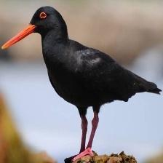
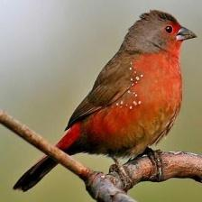
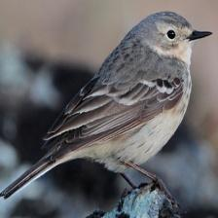
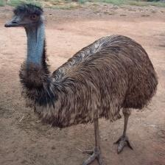
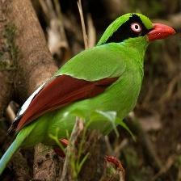
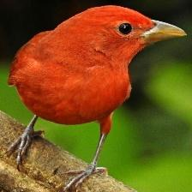
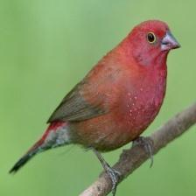
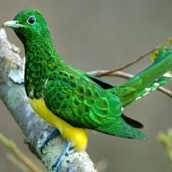
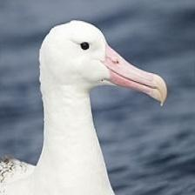
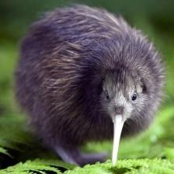
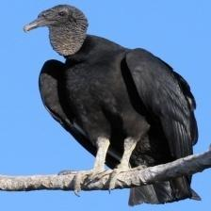
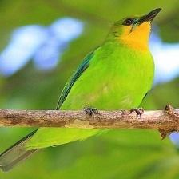

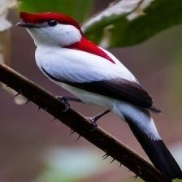
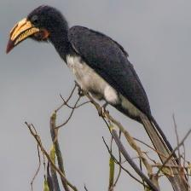
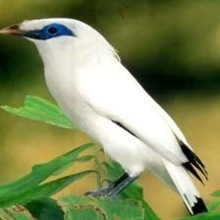
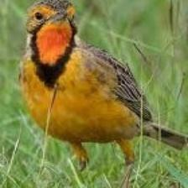
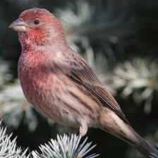
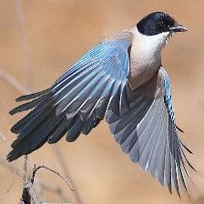
VGG16
3. Select 60 target images that have pair images with high similarity in one layer and low similarity in the contrast two layers
1. Extract vector representation for all images after each max pooling layer
2,500 images
2. Compute cosine similarity between all pairs for each layer of representation
Distractor
Target
Layer 1
Layer 2
Layer 3
Select pool 1,3,6 layers
…
…
…
Pool 1
…
Pool 2
…
…
Pool 6
…

Slide 8
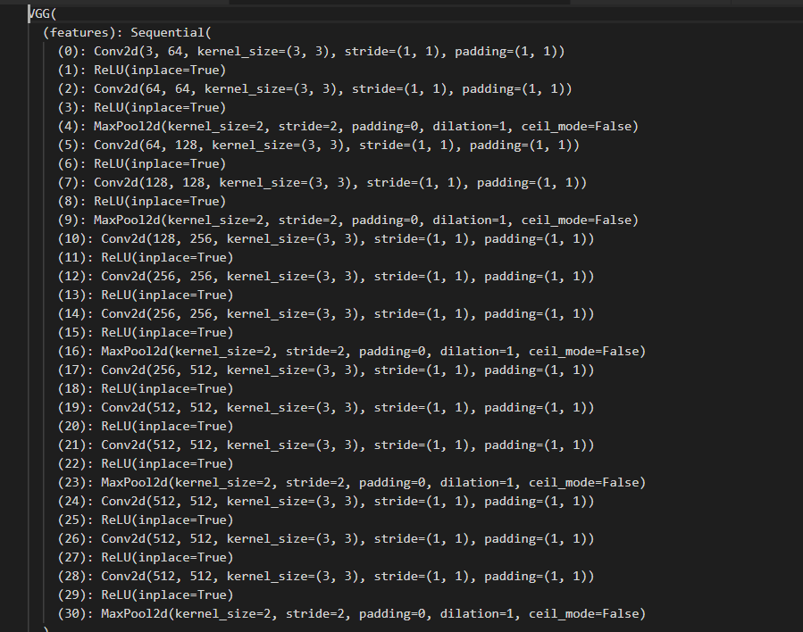
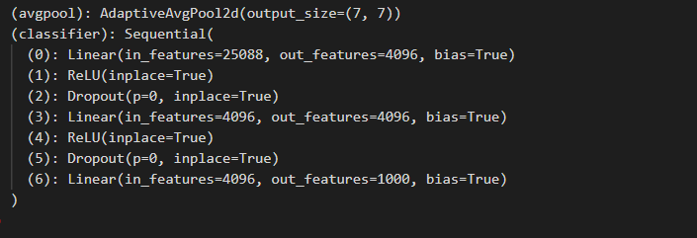

Slide 9
Creating the experiment
Using a dataset of fungi: objects that will be difficult to give a semantic label
Participants are requested to memorize the 60 target images
In different groups (retention interval length) participant will perform a 2afc memory task (selecting the old image)
This will be done using M-turk with Pavlovia

Slide 10
Creating the experiment
Calculate the cosine similarity between all images from all layers of representations.
Define the conditions:
Low level : layer 1
Middle level : layers 3
High level : layers 6
Select 60 target images (20 for each layer) that have the best occurrences of distractor images: that are similar and dissimilar to the other layers
For each target image – 3 distractors:
most similar and dissimilar from other conditions

Slide 11
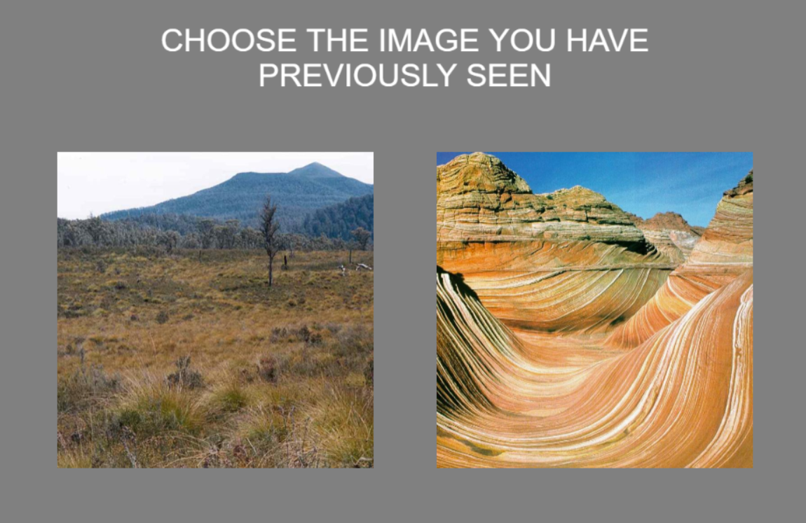
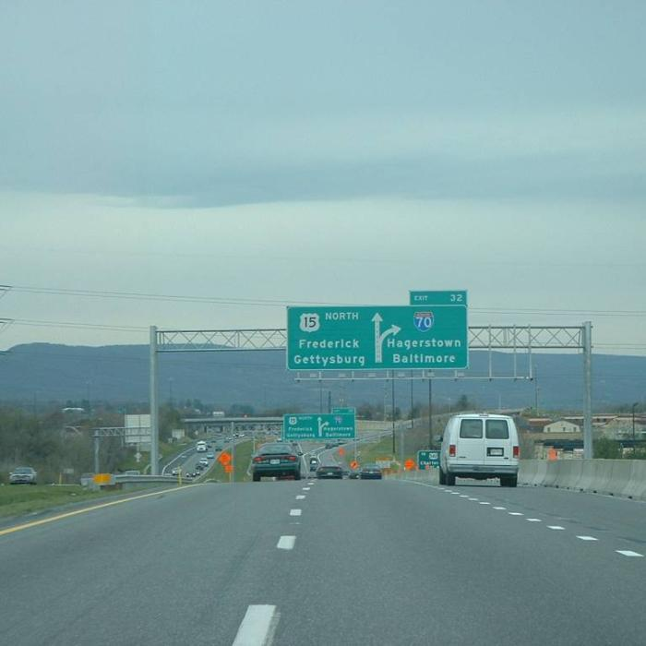
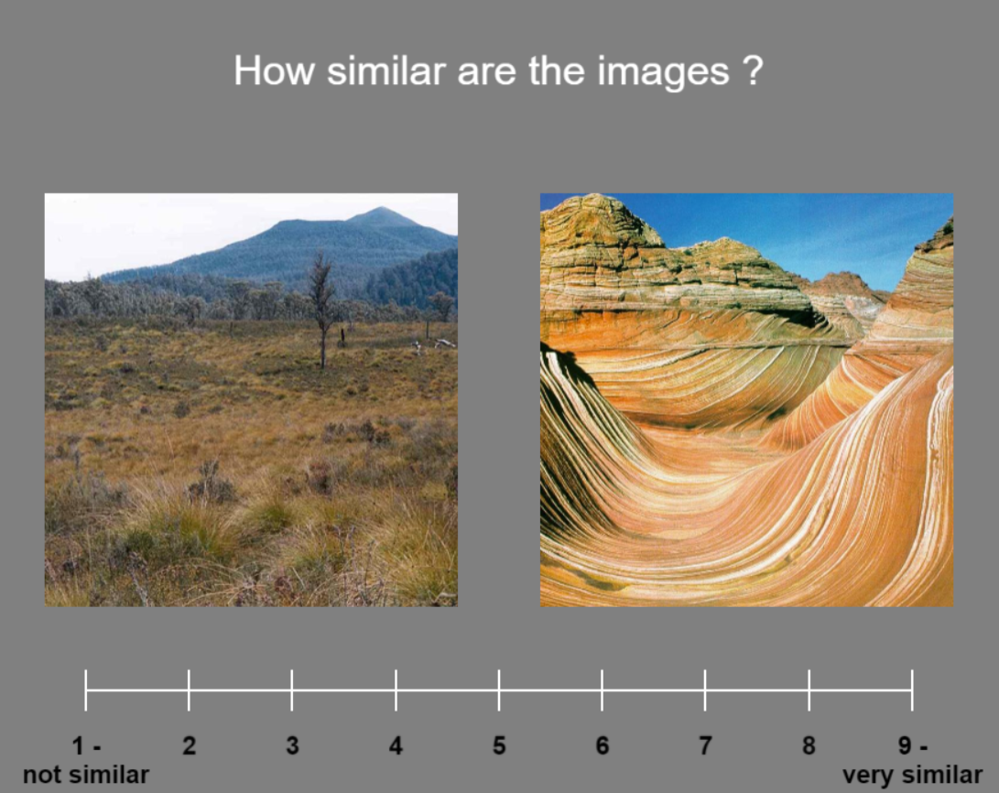
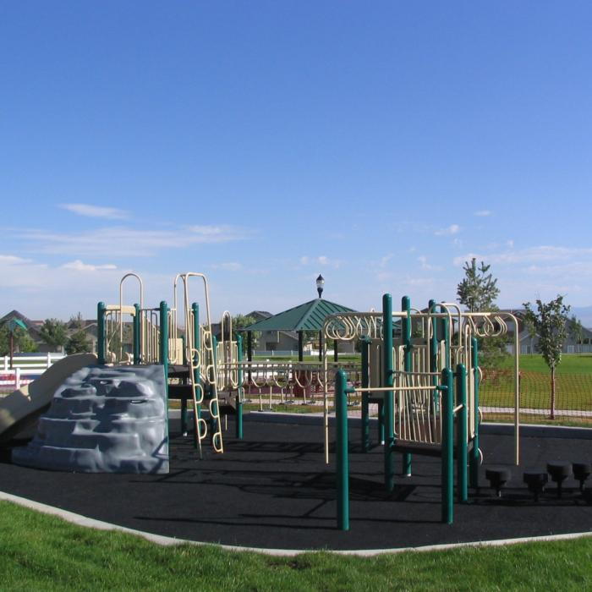
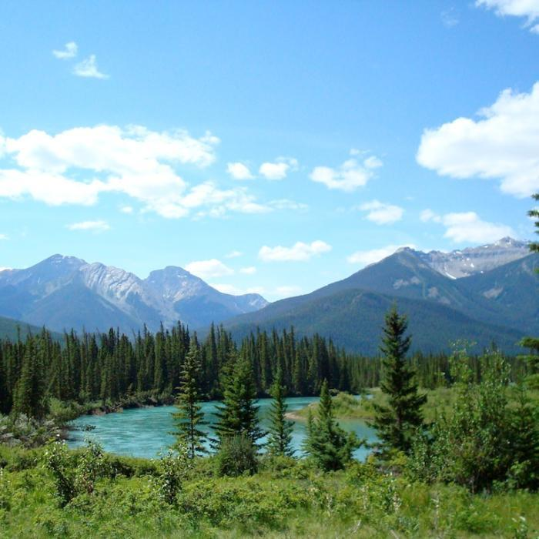
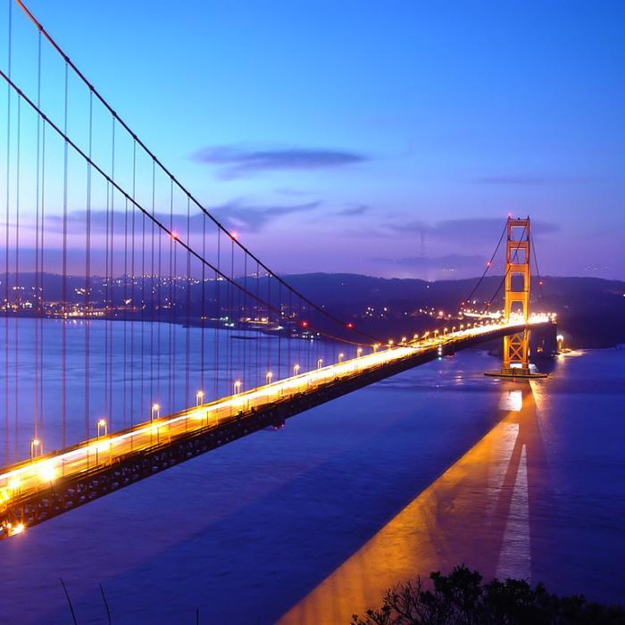
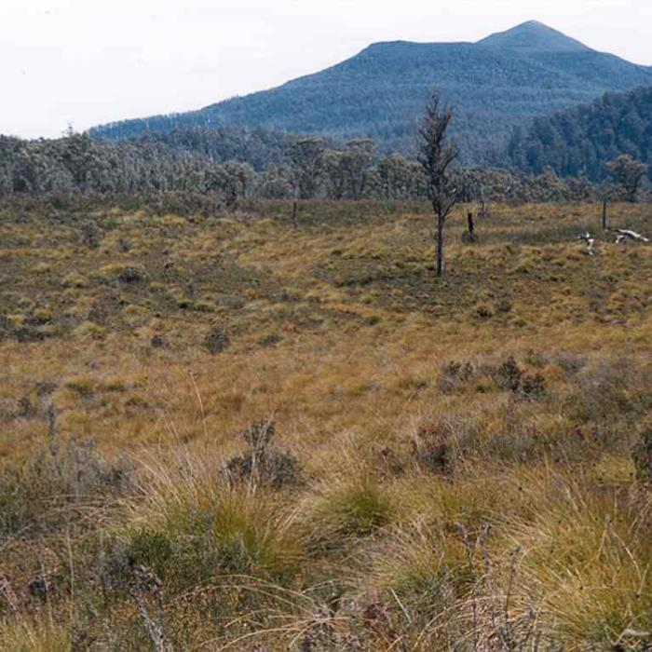
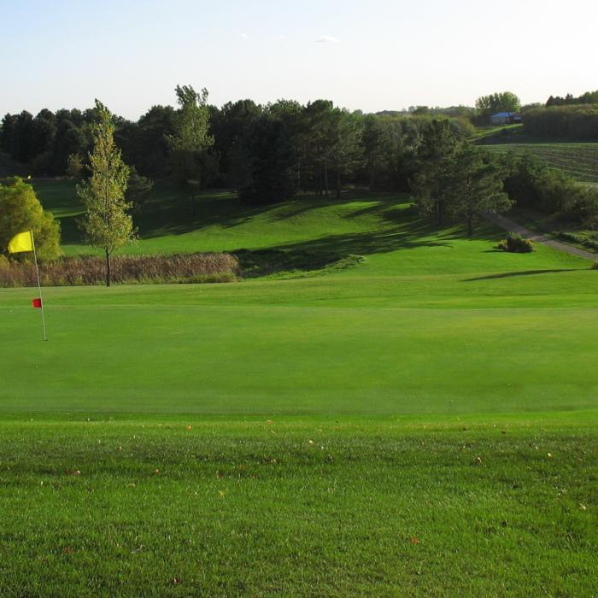
Test phase
Encoding phase
0.3 sec
…

Slide 12

Creating the experiment
Encoding phase
Immediately
24 hours
One week
Test phase

Slide 13
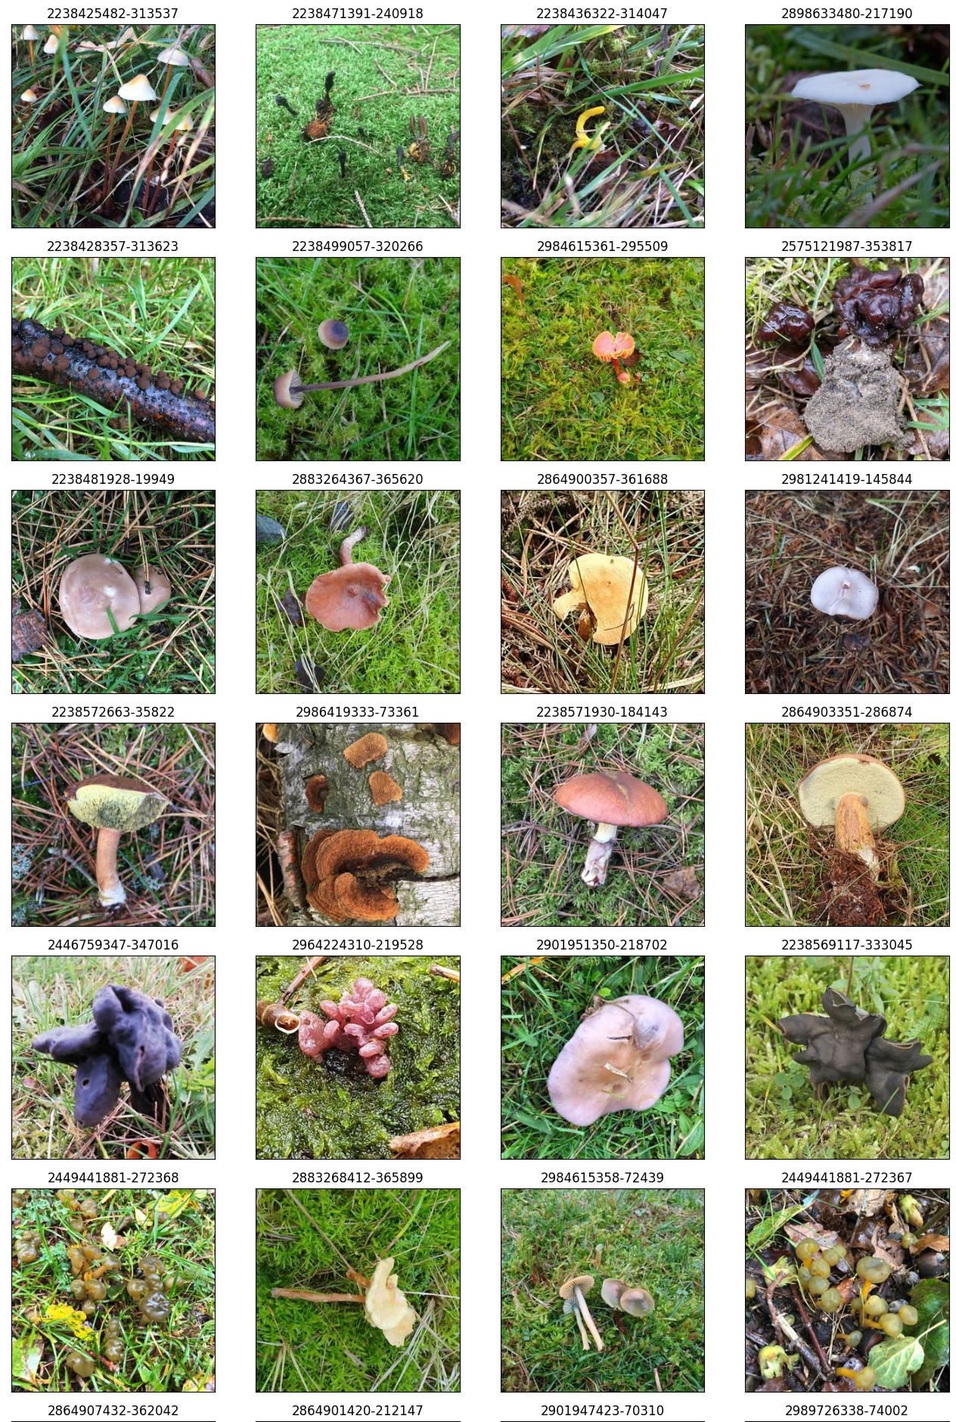
Creating the experiment

Slide 14
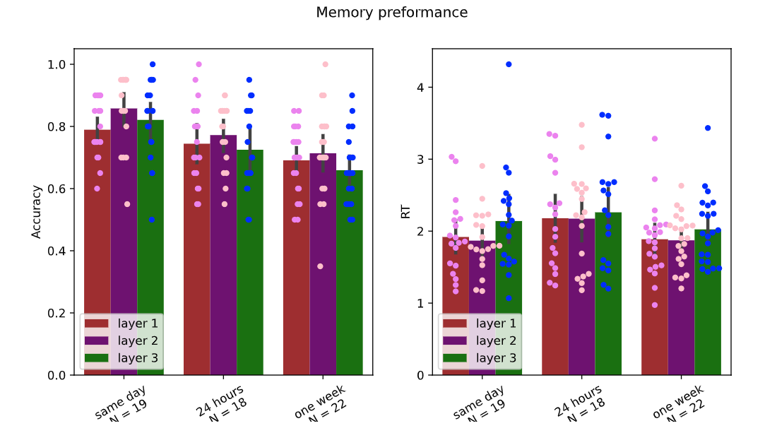
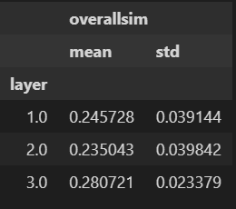
Results

Slide 15
Questions
Dataset with images that are more relatable?

Slide 16
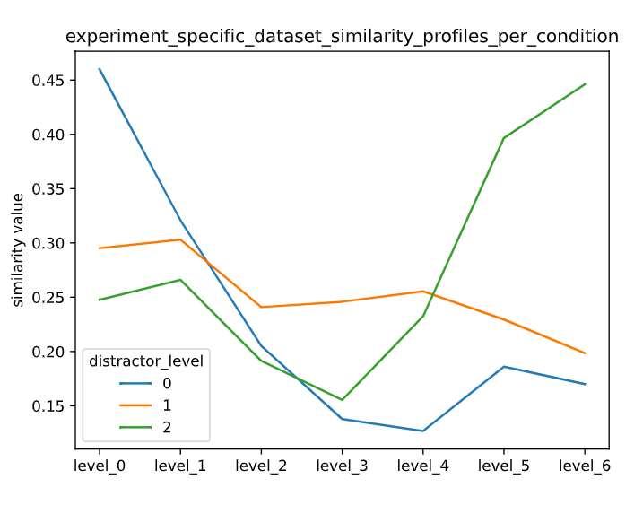
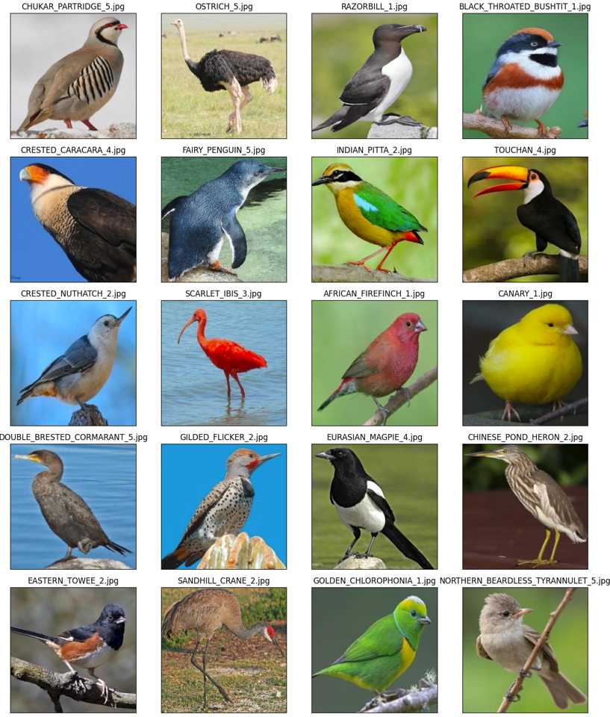
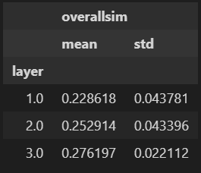
Birds dataset

Slide 17
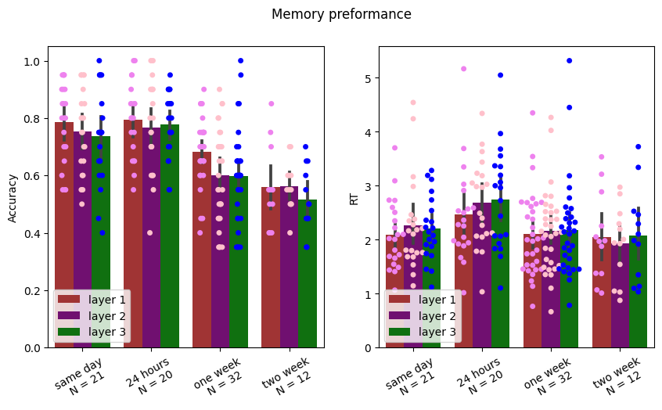
Results

Slide 18
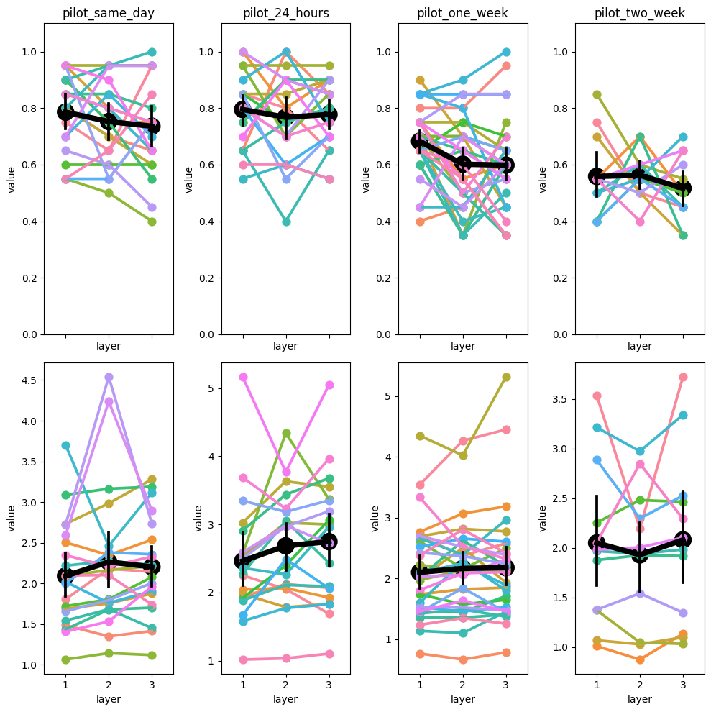

Slide 19
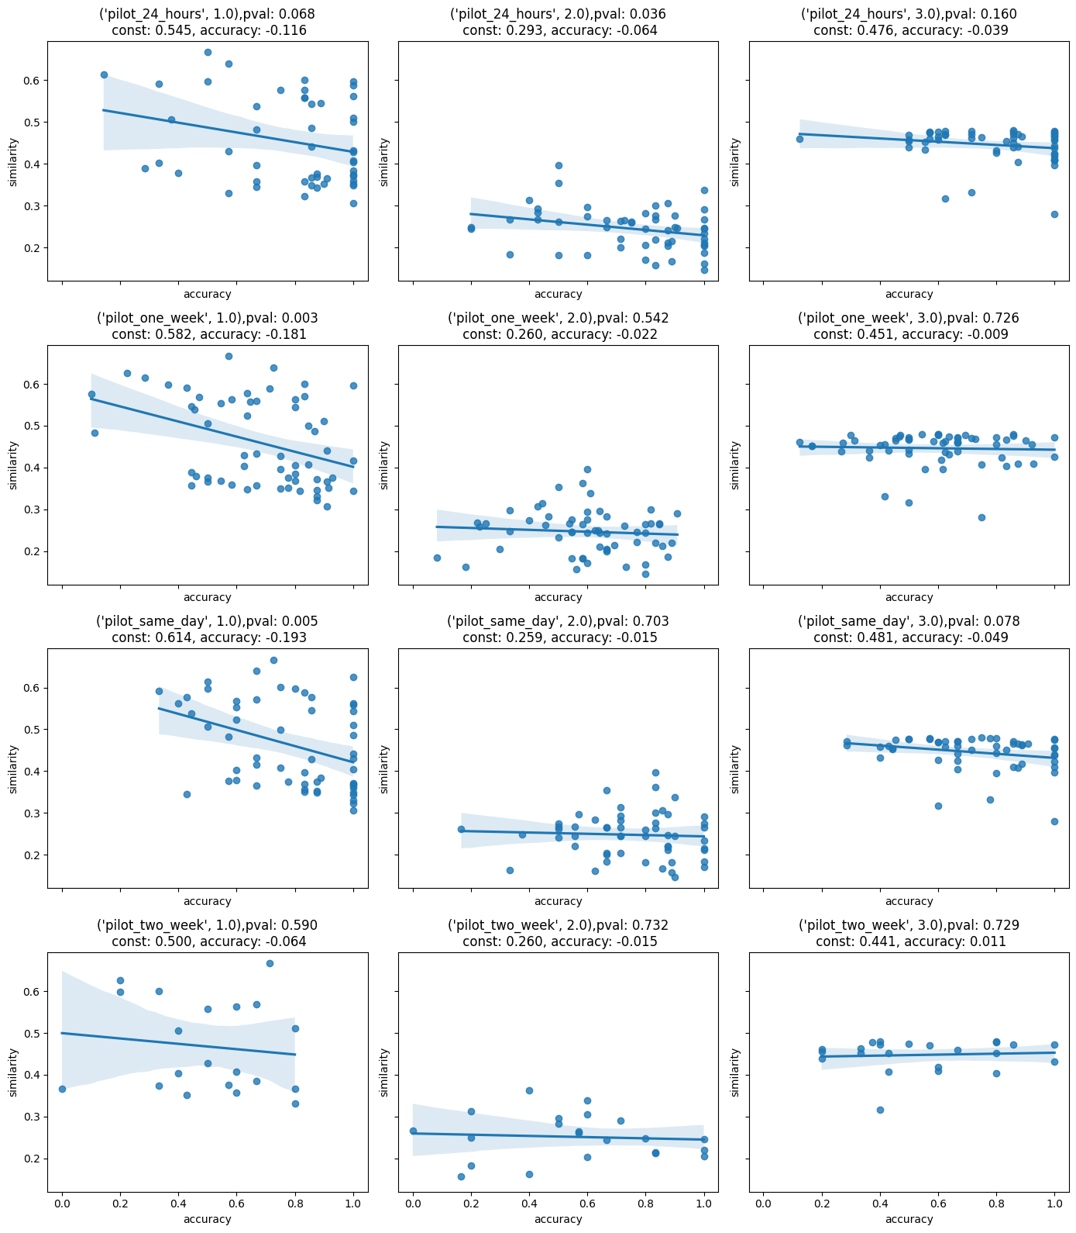

Slide 20
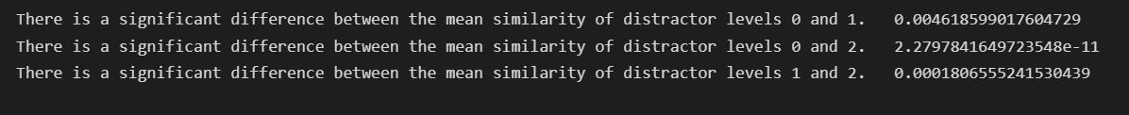
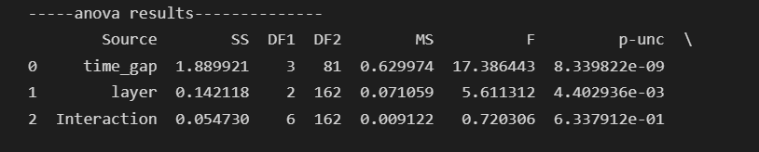
T-test between mean similarity of layers
ANOVA between time gaps within layer

Slide 21
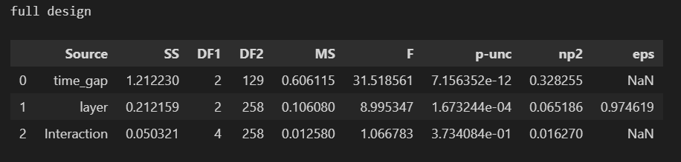
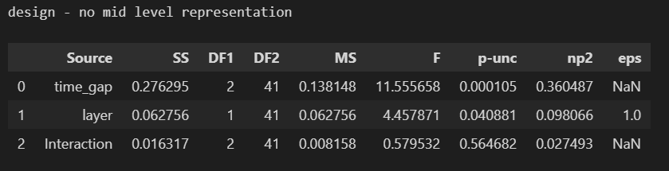
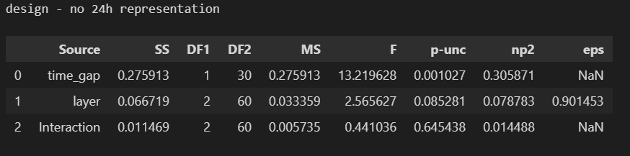

Slide 22
Questions
Main effect for layer – what could be the reason?
Using images with background when studies show humans encode the object.
Using a dataset of images all from the same category – limits the ability to find distractors that are similar in the first layer but dissimilar in the last.
Middle layer – what can we realy learn from the middle layers of a CNN?

Slide 23
Specific questions to Moni
1) does our chosen distance metric makes sense (cosine similarity)
Note that the vectors sizes differ between layers (they become smaller by 0.5)
2) is our choice of feature map extraction the optimal one?
We extract the feature maps following each conv block (1 conv + 1 relu, 1 conv 2 + relu, max pooling (extract))
3) can we figure out a decent algorithm to select the experimental images, in a way that will create the most distinct similarity over layers pattern
Note that similarities across the hierarchy of the network are
A: correlated
B: follow a u-shape pattern (meaning, the early and late layers are more similar than mid ones)
4) Mean similarity seems to matter in memory performance, currently we calculate the arithmetic mean of similarities over the 7 extracted layers
Maybe we should use a different mean?
Notes:
Transfer learning to the end layers of the network for the specific dataset
Similarity metric between images – calculate similarity between specific neurons in the layer , pick a subset of X neurons that have an activation above a threshold
Features maps – (we choose after the maxpooling layers) choosing the maxpooling is a sample layer, and not like a conv layer that has a monotonic transformation.

Slide 24
Moni’s answers
Transfer learning to the end layers of the network for the specific dataset
Similarity metric between images – calculate similarity between specific neurons in the layer , pick a subset of X neurons that have an activation above a threshold
PLAN A
- build a function that takes only neurons that are above a threshold for both images or take neurons that the mean activation is about a threshold
- parameter for number of neurons to consider
- different threshold for each layer?
PLAN B
- take only the most activated neurons in the dataset (top X)
Features maps – (we choose after the maxpooling layers) choosing the maxpooling is a sample layer, and not like a conv layer that has a monotonic transformation. Look at the metrics used in the object detection world that is invariant to the location of the objects in the image.
Mean similarity - maybe use a different mean metric ? Maybe harmonic mean – this mean punishes the values that are close to zero (dissimilar images)
Use any network – using the results from the vgg16 network on a new network
Our algorithm – maybe use matching? Calculate a general norm - pick a target
- look at all the distractors that have a value above X
- constraint: the general mean is the same

Slide 25
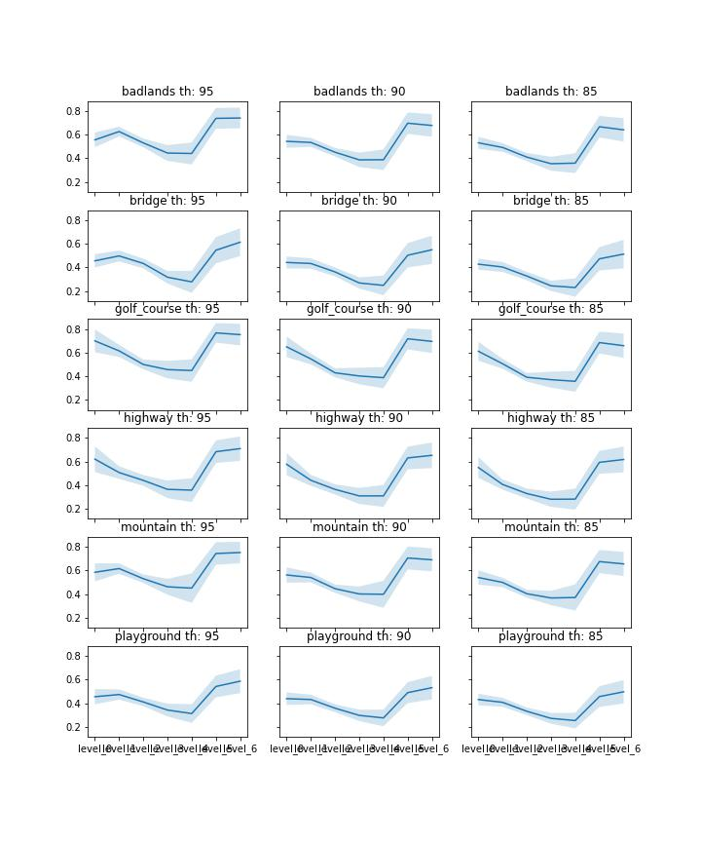
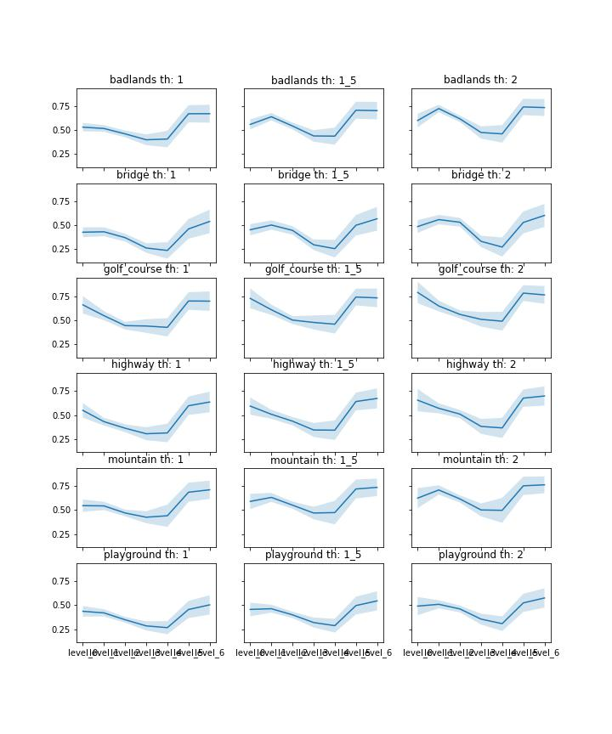
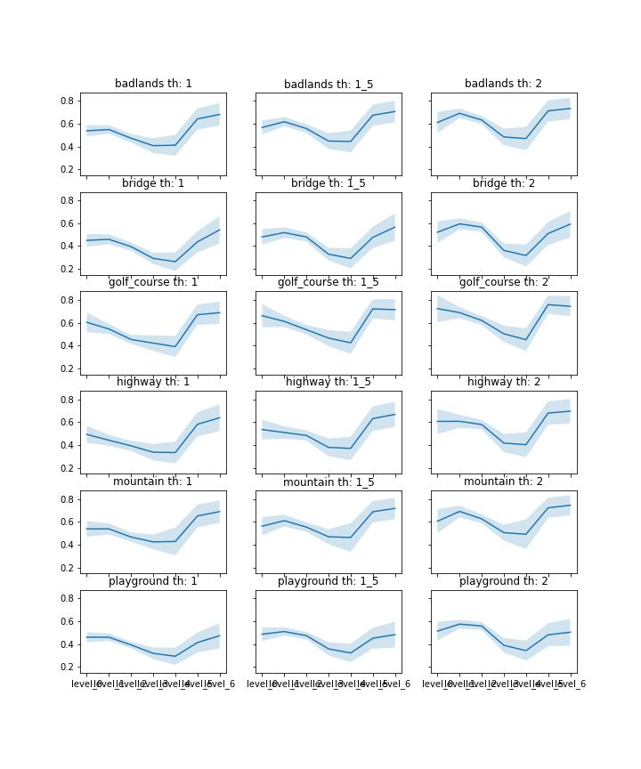
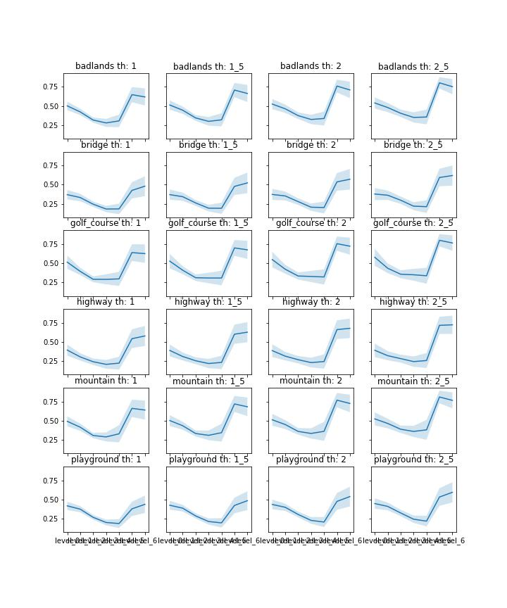
Mean similarity using the topmost activated neurons in the network (with percentiles) per category– same neurons for all calculations of similarity per category
Mean similarity using the topmost activated neurons in the network (with standard deviations) per category– same neurons for all calculations of similarity per category
Mean similarity using the topmost activated neurons in the network (with standard deviations) over the whole dataset – same neurons for all calculations of similarity
Mean similarity using the neurons with high mean similarity for each image pair – different neurons for all calculations of similarity

Slide 26
Current (crappy) selection algorithm
1. calculate similarity weighted by contrasts:
Select weight feature maps to weight for contrasts:
Early: first max pool following conv block
Late: before last classifier (after relu) before the last classifier (which is too tuned to the specific categories of the trained network)
1. Create two contrasts, with weights 1 and -1 and -1 and 1
2. select target images:
Create the occurrences matrix, which counts how many potential distractors for each target exceed some pre-defined threshold (on the actual similarity) :
For each contrast we want images that have a similarity of [[>0.2,<0.6],[<0.4,>0.0]]
For each category takes the 5 images that have the biggest number of matches based on the criterions
3. select distractors:
For each selected target, select the distractor that has the highest contrast similarity subjected to constraints on actual similarity
Note this allow us to try and enforce some min/max similarity values to try and create a more distinct sim pattern over the network.
the problem: we can select any constraints values that we want, as when they are too high/low no distractor images can be found
Note: we think that maybe if our algorithm also was allowed to change the selected targets from the previous section it might work better?

